Slide 1

HIGHSCHOOL DATABASE
GROUP 7
THE TEAM
Dalton Kagumu
Nelson Mwangi
Sammy Lewis
Collins Kamau

Slide 2

Purpose
Centralizing student information for easier access and management.
Facilitating efficient communication among stakeholders.
Empowering data-driven decision-making for administrators and policymakers.

Slide 3
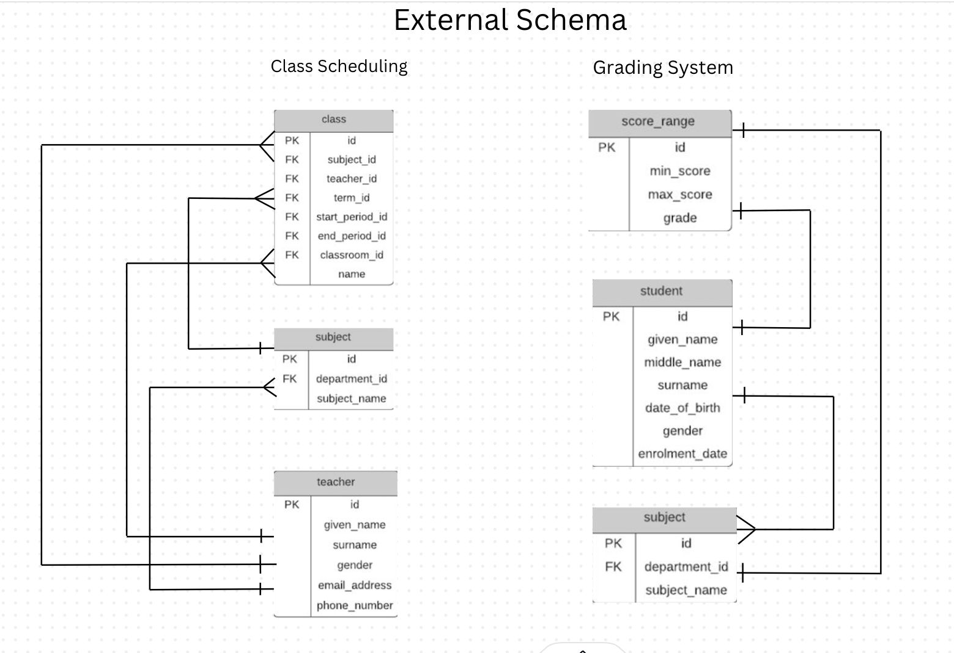

Slide 4
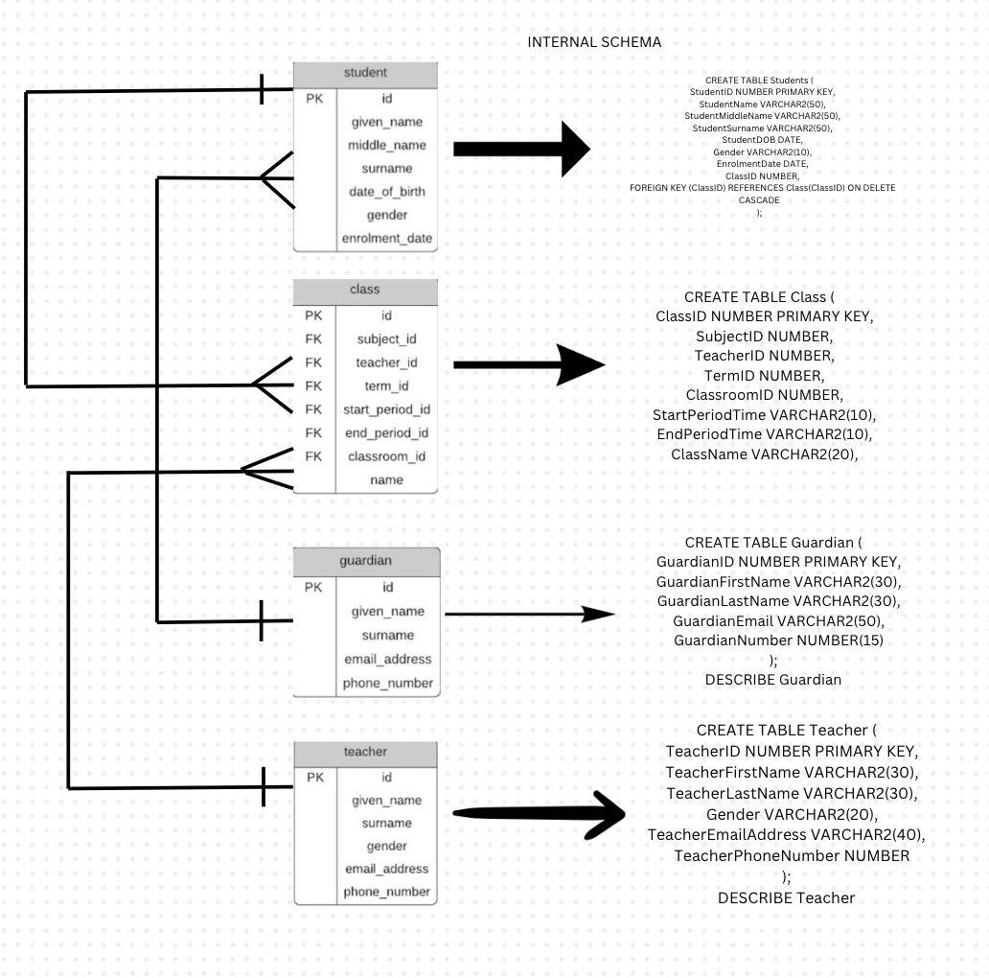

Slide 5
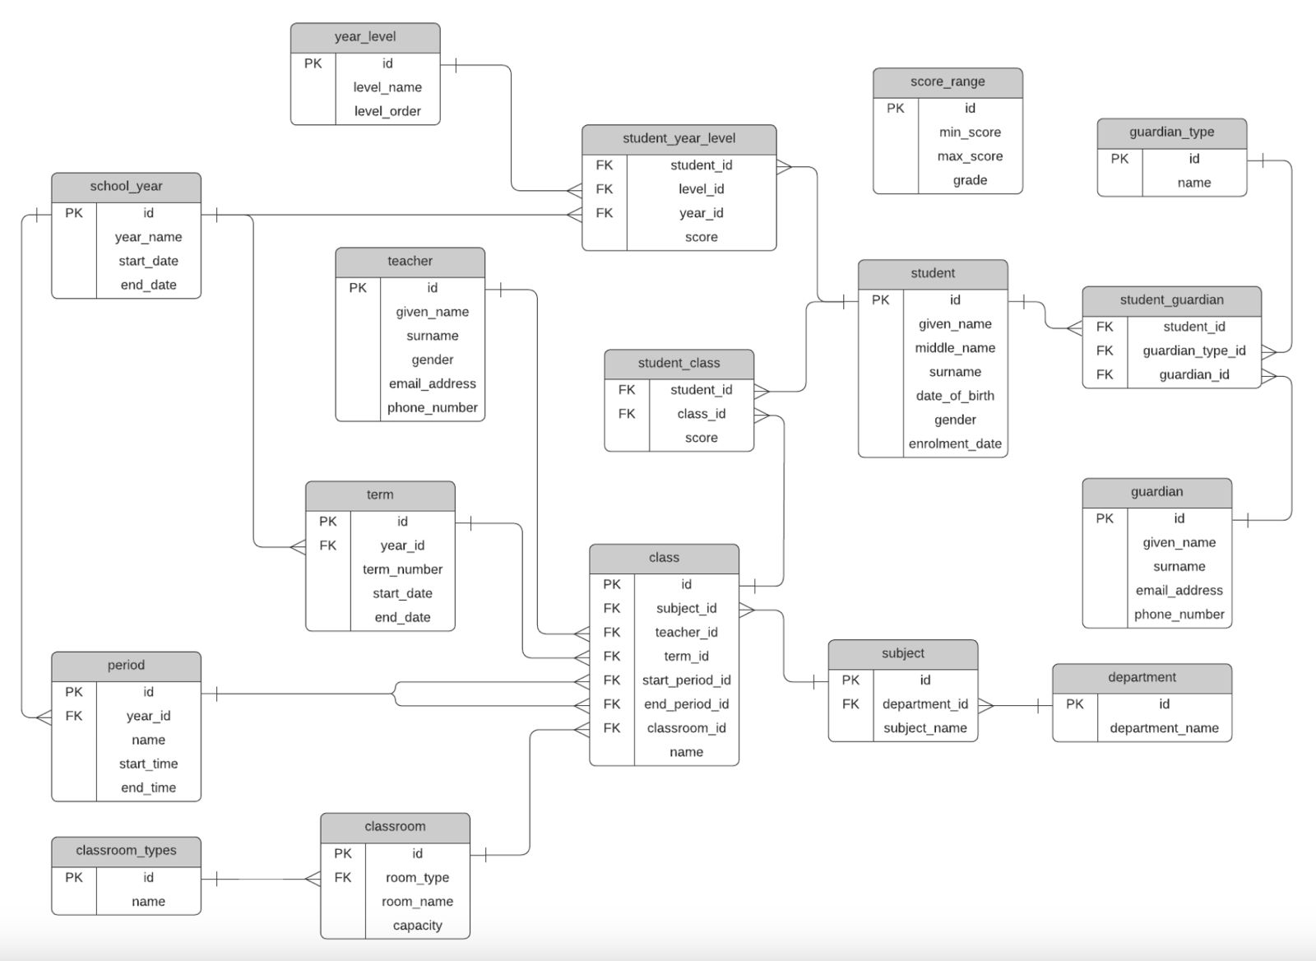
CONCEPTUAL SCHEMA

Slide 6

Benefits
Improved organization of student information.
Efficient communication between stakeholders.
Data-driven decision making for administrators and policymakers.
Personalized learning based on student profiles.
Streamlined administrative processes through automation.
Enhanced security and privacy for student data.

Slide 7

THANK YOU

